Slide 1
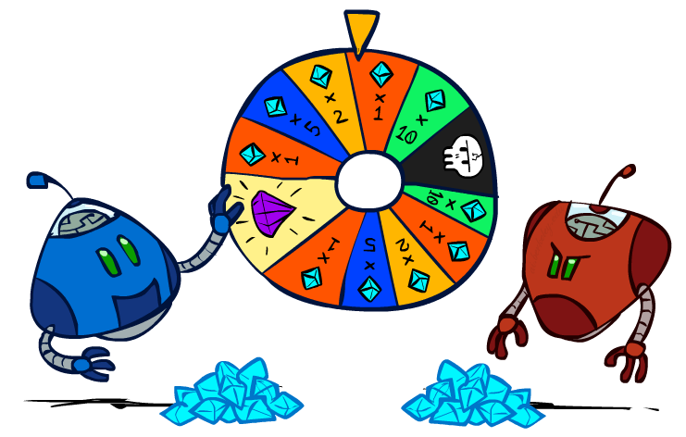
CS 106: Artificial Intelligence
Expectimax, Uncertainty, and Utilities
Instructor: Ngoc-Hoang LUONG, PhD.
University of Information Technology (UIT), VNU-HCM
[These slides were adapted from the slides created by Dan Klein and Pieter Abbeel for CS188 Intro to AI at UC Berkeley. http://ai.berkeley.edu.]
Notes:
Please retain proper attribution, including the reference to ai.berkeley.edu. Thanks!

Slide 2
A simple game
You choose one of the three bins.
I choose a number from that bin.
Your goal is to maximize the chosen number.
A
-$50 $50
B
$1 $5
C
-$10 $20

Slide 3
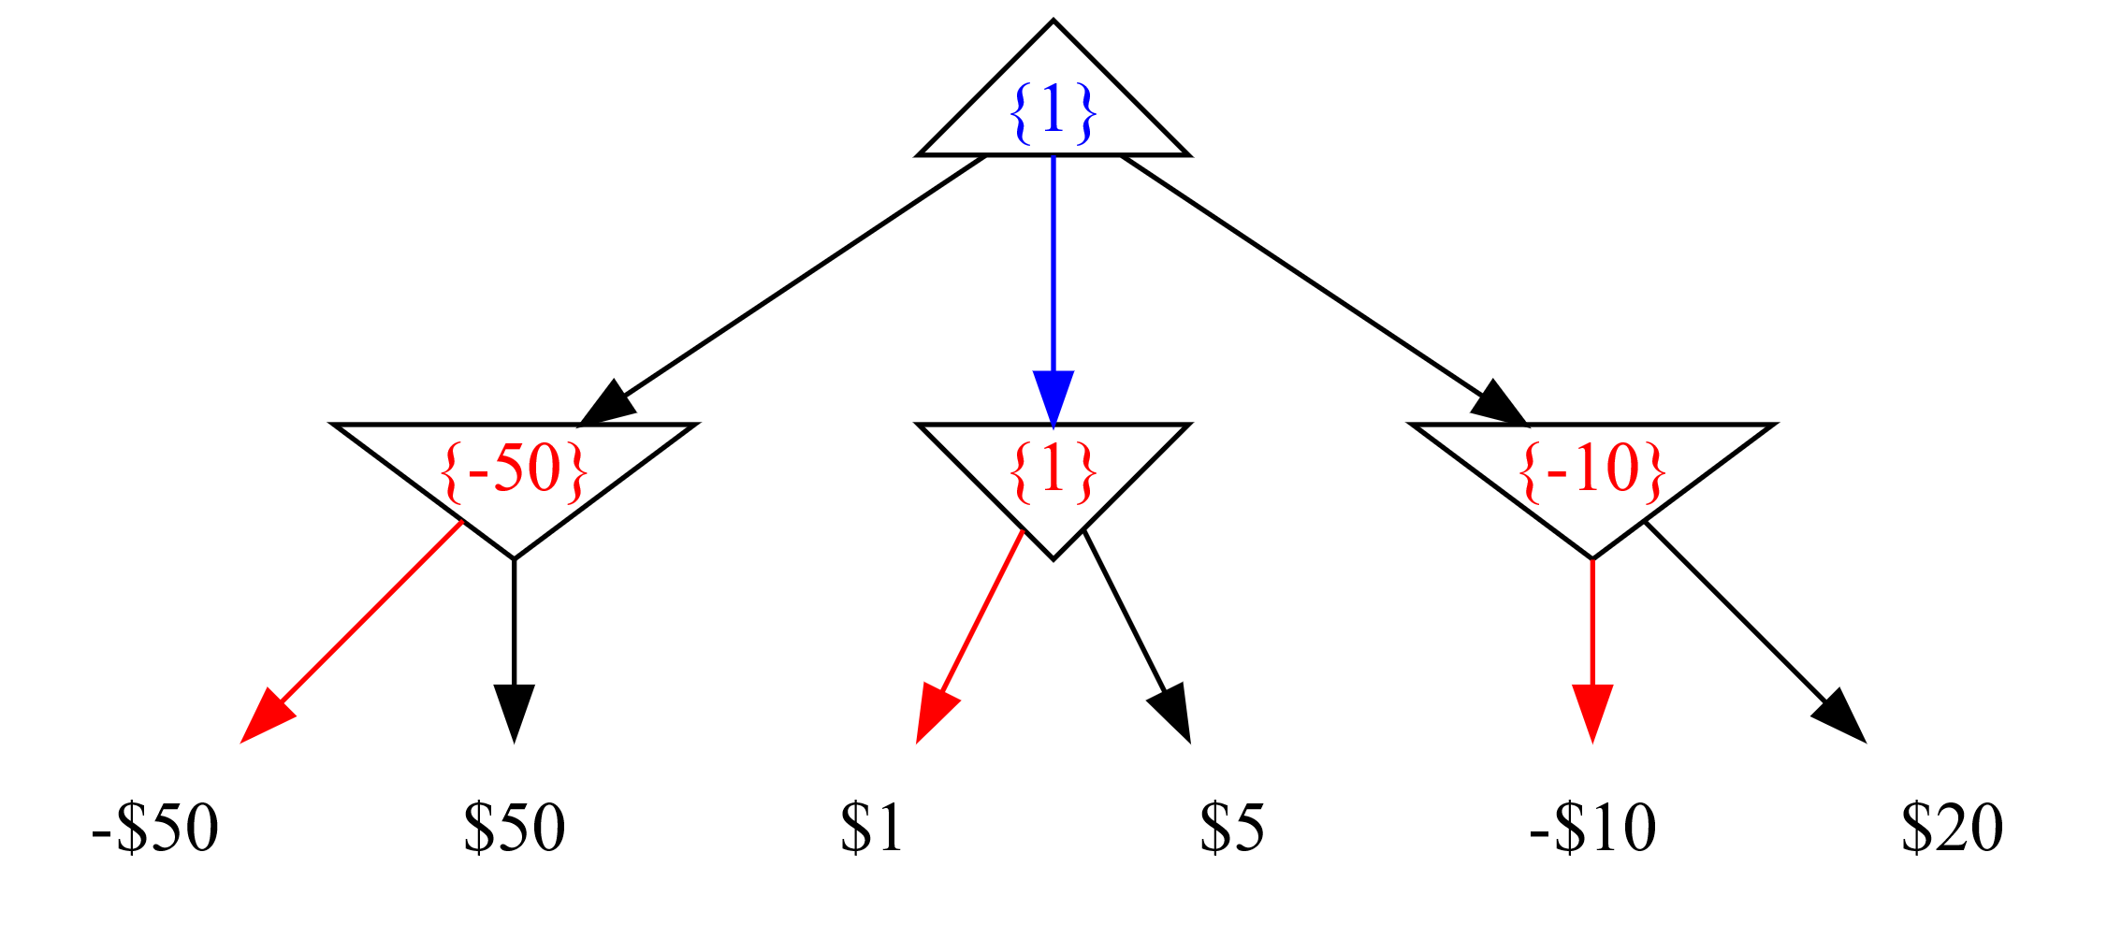
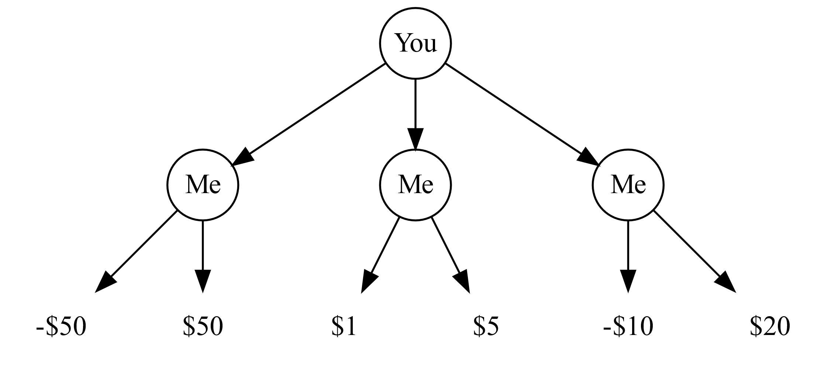
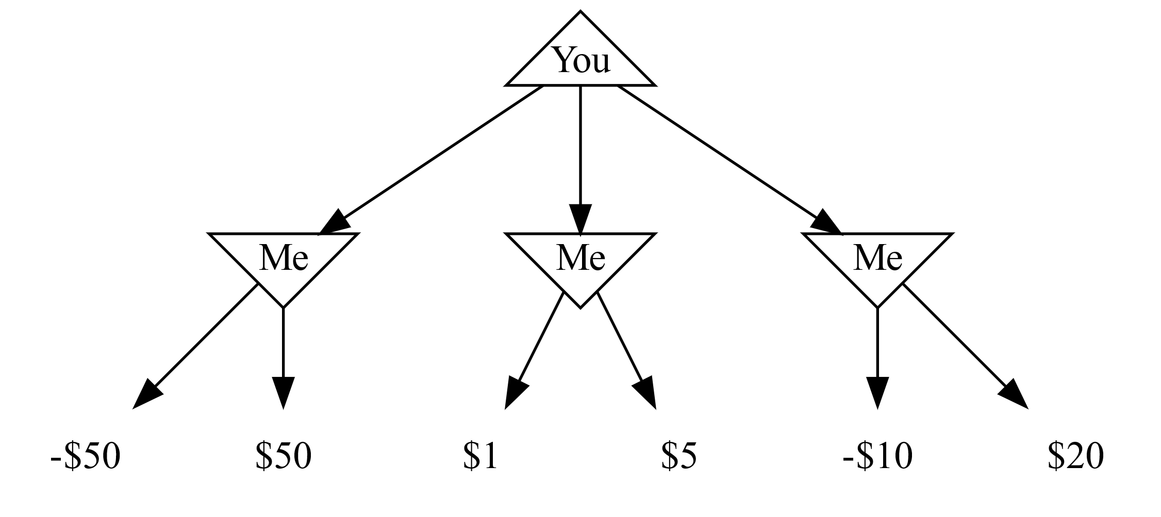
Game tree
Each node is a decision point for a player.
Each root-to-leaf path is a possible outcome of the game.
Your goal is to maximize the chosen number.

Slide 4
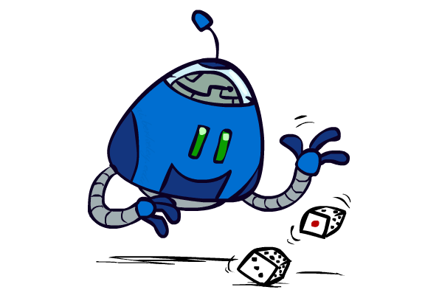
Uncertain Outcomes

Slide 5
Uncertain Outcomes
You choose one of the three bins.
I toss a fair coin. If head, the bigger number is returned. If tail, the smaller number is returned.
Your goal is to maximize the chosen number.
A
-$50 $50
B
$1 $5
C
-$10 $20

Slide 6
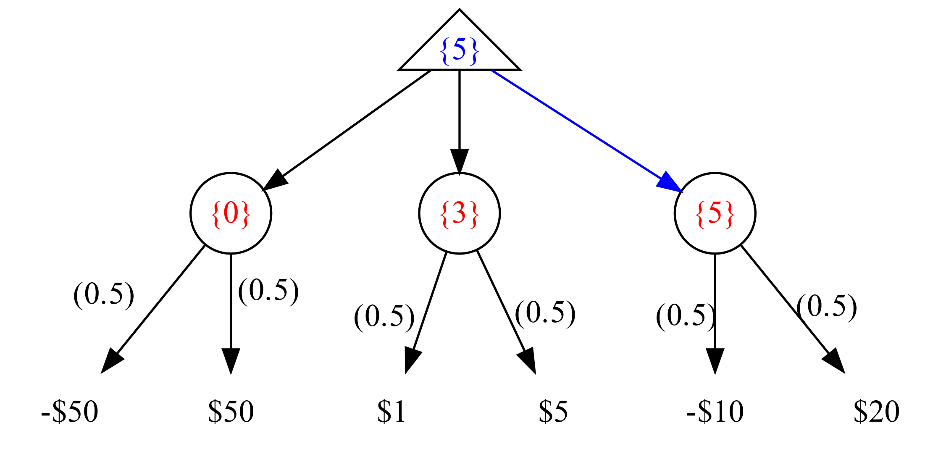
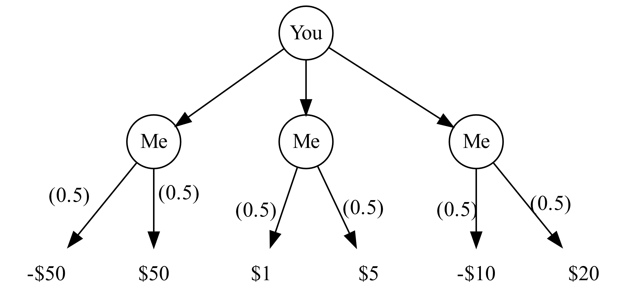
Uncertain Outcomes
You choose one of the three bins.
I toss a fair coin. If head, the bigger number is returned. If tail, the smaller number is returned.
Your goal is to maximize the chosen number.

Slide 7
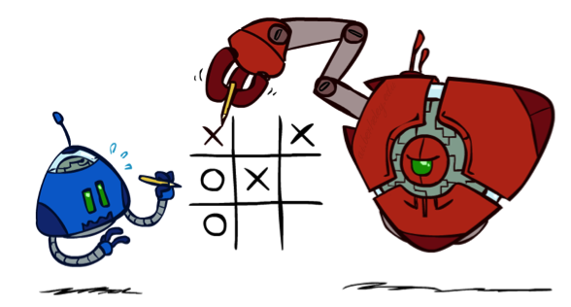

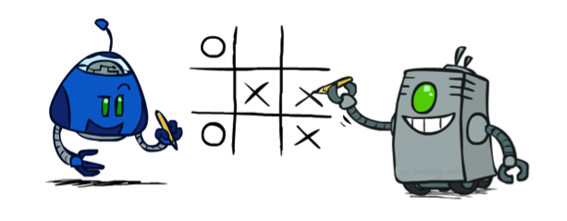
Worst-Case vs. Average Case
max
min
10
10
9
100
Idea: Uncertain outcomes controlled by chance, not an adversary!
Notes:
At least 10, or otherwise just rather dead; or just 100, or otherwise rather dead; that’s yet something different than minimax or expectimax

Slide 8
Expectimax Search
Why wouldn’t we know what the result of an action will be?
Explicit randomness: rolling dice
Unpredictable opponents: the ghosts respond randomly
Actions can fail: when moving a robot, wheels might slip
Values should now reflect average-case (expectimax) outcomes, not worst-case (minimax) outcomes
Expectimax search: compute the average score under optimal play
Max nodes as in minimax search
Chance nodes are like min nodes but the outcome is uncertain
Calculate their expected utilities
I.e. take weighted average (expectation) of children
Later, we’ll learn how to formalize the underlying uncertain-result problems as Markov Decision Processes
max
chance
10
10
4
10
5
9
7
100
[Demo: min vs exp (L7D1,2)]

Slide 9

Video of Demo Minimax vs Expectimax (Min)

Slide 10
Video of Demo Minimax vs Expectimax (Exp)

Slide 11
Expectimax Pseudocode
def value(state):
if the state is a terminal state: return the state’s utility
if the next agent is MAX: return max-value(state)
if the next agent is EXP: return exp-value(state)
def max-value(state):
initialize v = -∞
for each successor of state:
v = max(v, value(successor))
return v
def exp-value(state):
initialize v = 0
for each successor of state:
p = probability(successor)
v += p * value(successor)
return v
Notes:
Pick an order for two reasons: sequential processor and pruning

Slide 12
Expectimax Pseudocode
def exp-value(state):
initialize v = 0
for each successor of state:
p = probability(successor)
v += p * value(successor)
return v
1/2
1/6
1/3
5
8
7
24
-12
v = (1/2) (8) + (1/3) (24) + (1/6) (-12) = 10

Slide 13
Expectimax Example
8
8
4
7
3
12
9
2
4
6
15
6
0

Slide 14
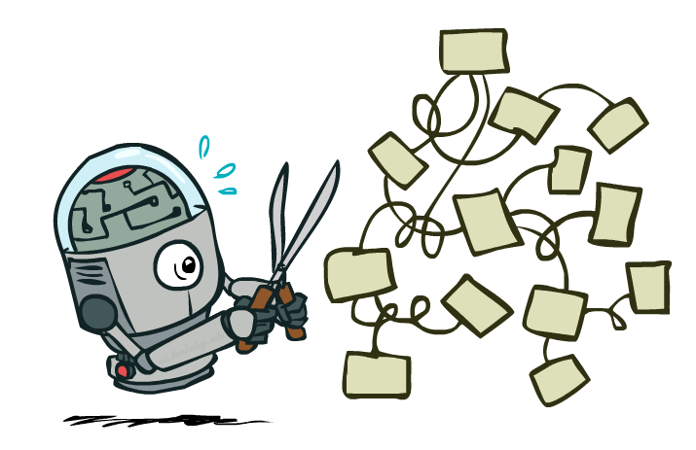
Expectimax Pruning?
3
12
9
2

Slide 15



Depth-Limited Expectimax
Estimate of true expectimax value (which would require a lot of work to compute)
400
300
…
…
492
362
…

Slide 16
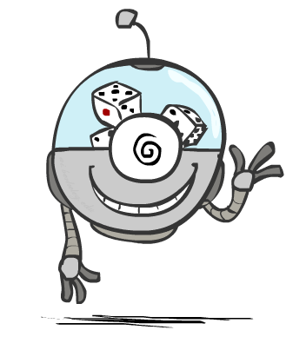
Probabilities

Slide 17
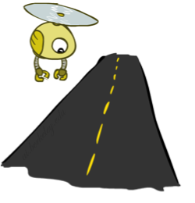
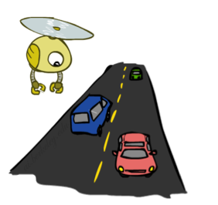
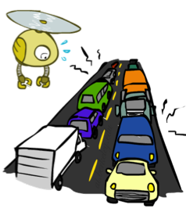
Reminder: Probabilities
A random variable represents an event whose outcome is unknown
A probability distribution is an assignment of weights to outcomes
Example: Traffic on freeway
Random variable: T = whether there’s traffic
Outcomes: T in {none, light, heavy}
Distribution: P(T=none) = 0.25, P(T=light) = 0.50, P(T=heavy) = 0.25
Some laws of probability (more later):
Probabilities are always non-negative
Probabilities over all possible outcomes sum to one
As we get more evidence, probabilities may change:
P(T=heavy) = 0.25, P(T=heavy | Hour=8am) = 0.60
We’ll talk about methods for reasoning and updating probabilities later
0.25
0.50
0.25

Slide 18
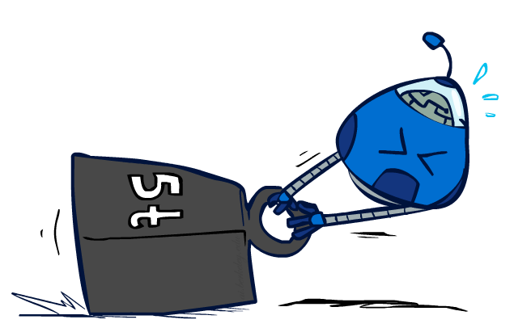
Reminder: Expectations
The expected value of a function of a random variable is the average, weighted by the probability distribution over outcomes
Example: How long to get to the airport?
Time:
20 min
30 min
60 min
+
+
35 min
x
x
x
Probability:
0.25
0.50
0.25

Slide 19
What Probabilities to Use?
In expectimax search, we have a probabilistic model of how the opponent (or environment) will behave in any state
Model could be a simple uniform distribution (roll a die)
Model could be sophisticated and require a great deal of computation
We have a chance node for any outcome out of our control: opponent or environment
The model might say that adversarial actions are likely!
Having a probabilistic belief about another agent’s action does not mean that the agent is flipping any coins!

Slide 20
Quiz: Informed Probabilities
Let’s say you know that your opponent is actually running a depth 2 minimax, using the result 80% of the time, and moving randomly otherwise
Question: What tree search should you use?
Answer: Expectimax!
To figure out EACH chance node’s probabilities, you have to run a simulation of your opponent
This kind of thing gets very slow very quickly
Even worse if you have to simulate your opponent simulating you…
… except for minimax, which has the nice property that it all collapses into one game tree
0.1 0.9

Slide 21
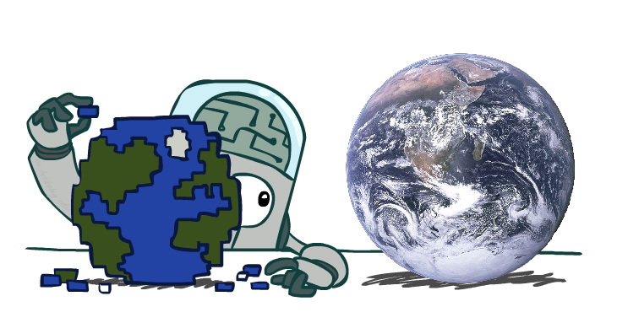
Modeling Assumptions

Slide 22
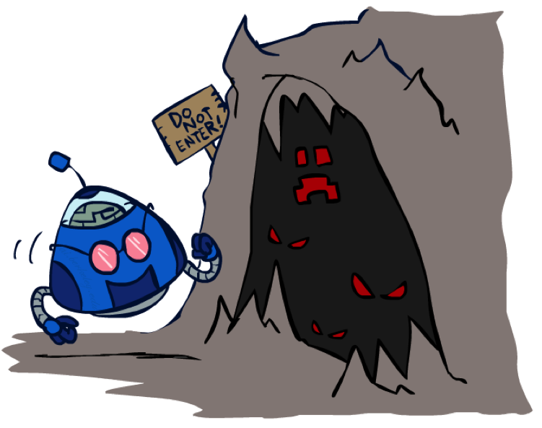
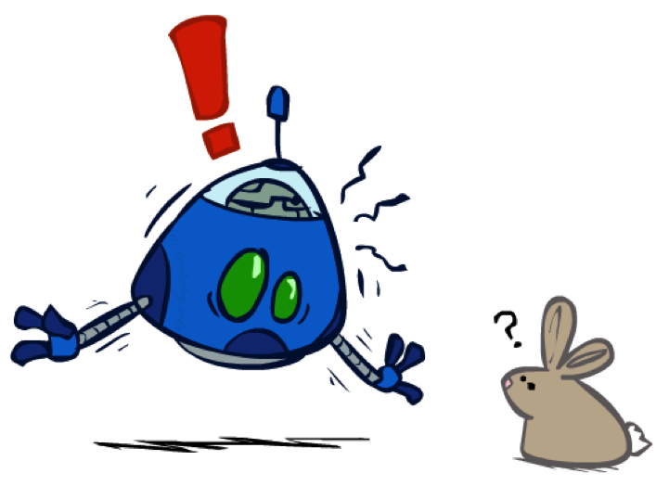
The Dangers of Optimism and Pessimism
Dangerous Optimism
Assuming chance when the world is adversarial
Dangerous Pessimism
Assuming the worst case when it’s not likely

Slide 23
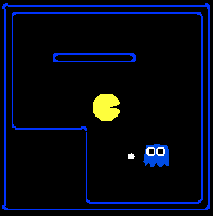
Assumptions vs. Reality
 | Adversarial Ghost | Random Ghost
Minimax Pacman | Won 5/5 Avg. Score: 483 | Won 5/5 Avg. Score: 493
Expectimax Pacman | Won 1/5 Avg. Score: -303 | Won 5/5 Avg. Score: 503
Results from playing 5 games
Pacman used depth 4 search with an eval function that avoids trouble Ghost used depth 2 search with an eval function that seeks Pacman
[Demos: world assumptions (L7D3,4,5,6)]
Notes:
python pacman.py -g SmartGhost -l trapped2 -p ExpectimaxAgent -a depth=4,evalFn=better

Slide 24
Video of Demo World Assumptions Random Ghost – Expectimax Pacman

Slide 25
Video of Demo World Assumptions Adversarial Ghost – Minimax Pacman

Slide 26
Video of Demo World Assumptions Adversarial Ghost – Expectimax Pacman

Slide 27
Video of Demo World Assumptions Random Ghost – Minimax Pacman

Slide 28
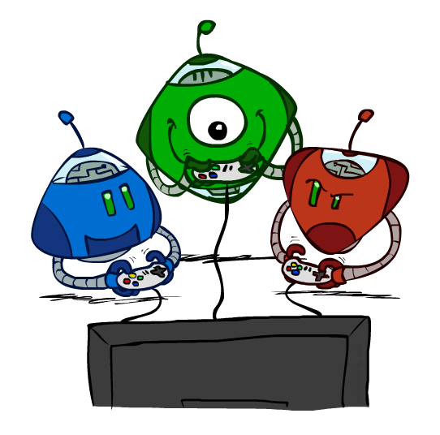
Other Game Types

Slide 29



Mixed Layer Types
E.g. Backgammon
Expectiminimax
Environment is an extra “random agent” player that moves after each min/max agent
Each node computes the appropriate combination of its children
Notes:
If it’s terminal or we reached our depth limit, return utility

Slide 30
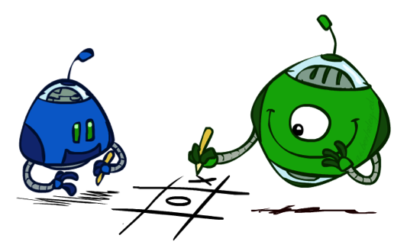
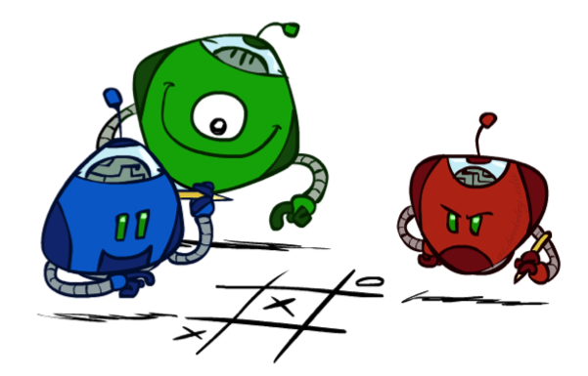
Multi-Agent Utilities
What if the game is not zero-sum, or has multiple players?
Generalization of minimax:
Terminals have utility tuples
Node values are also utility tuples
Each player maximizes its own component
Can give rise to cooperation and
competition dynamically…
5,2,5
1,6,6
5,2,5
1,6,6
6,1,2
5,1,7
5,2,5
1,6,6
7,1,2
6,1,2
7,2,1
5,1,7
1,5,2
7,7,1
5,2,5

Slide 31
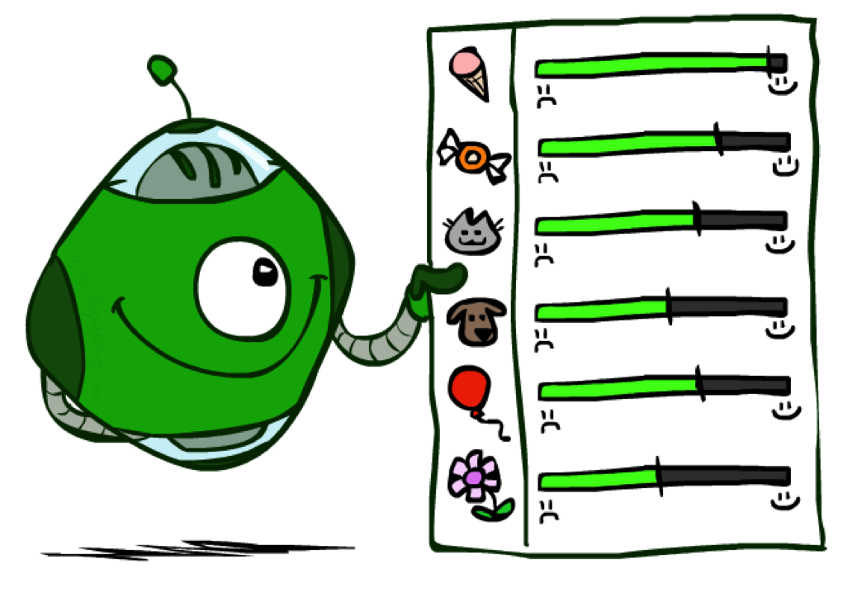
Utilities

Slide 32

Maximum Expected Utility
Why should we average utilities? Why not minimax?
Principle of maximum expected utility:
A rational agent should chose the action that maximizes its expected utility, given its knowledge
Questions:
Where do utilities come from?
How do we know such utilities even exist?
How do we know that averaging even makes sense?
What if our behavior (preferences) can’t be described by utilities?

Slide 33
What Utilities to Use?
0
40
20
30
x²
0
1600
400
900
For worst-case minimax reasoning, terminal function scale doesn’t matter
We just want better states to have higher evaluations (get the ordering right)
We call this insensitivity to monotonic transformations
For average-case expectimax reasoning, we need magnitudes to be meaningful

Slide 34

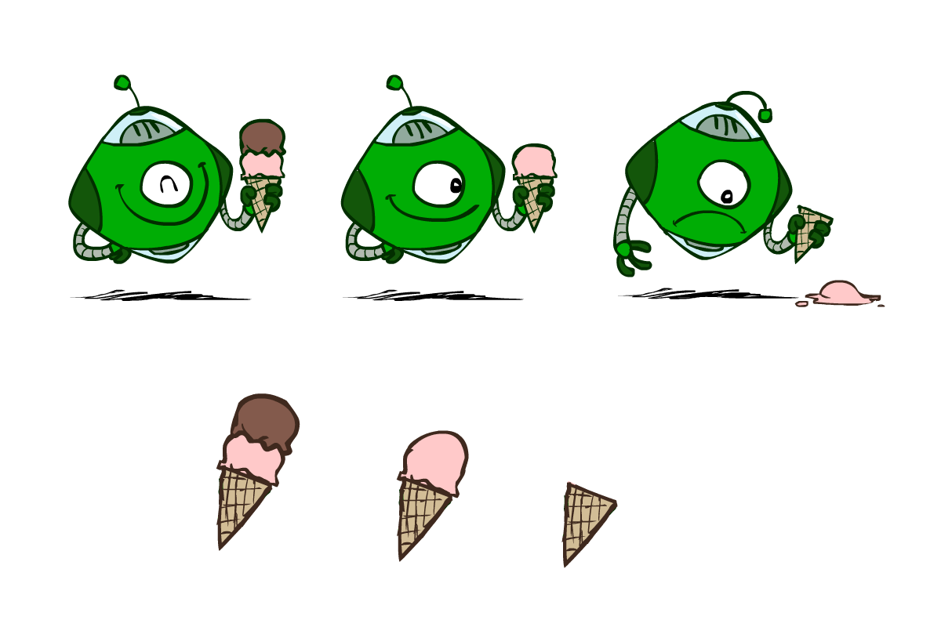
Utilities
Utilities are functions from outcomes (states of the world) to real numbers that describe an agent’s preferences
Where do utilities come from?
In a game, may be simple (+1/-1)
Utilities summarize the agent’s goals
Theorem: any “rational” preferences can be summarized as a utility function

Slide 35
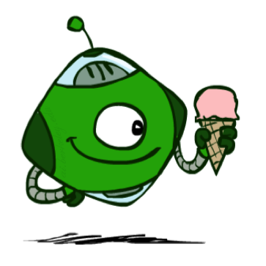
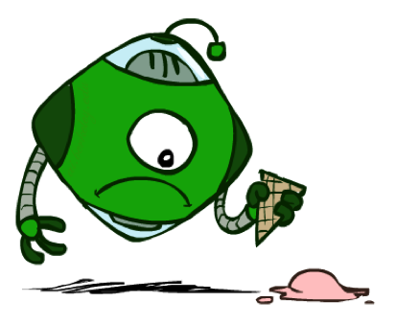
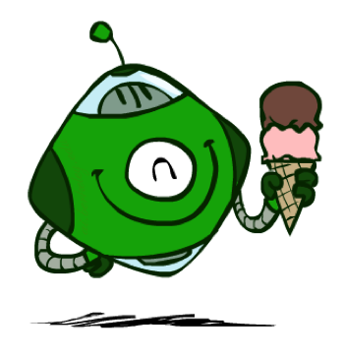
Utilities: Uncertain Outcomes
Getting ice cream
Whether to go for single or double?
The probability of dropping?
The utility values?
Get Single
Get Double
Oops
Whew!

Slide 36
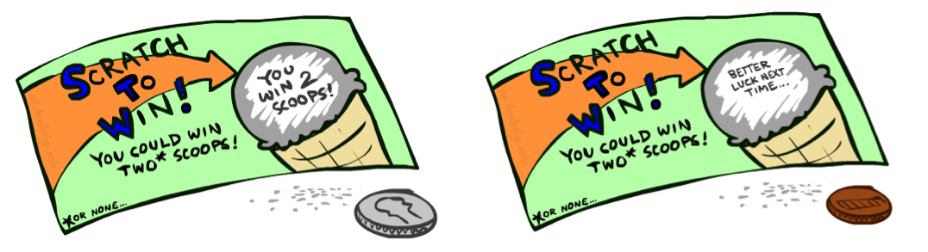
Preferences
A Prize
A Lottery
An agent must have preferences among:
Outcome → Prizes: A, B, etc.
Probabilities → Lotteries: situations with uncertain prizes
Notation:
Preference:
Indifference:
A
p 1-p
A B

Slide 37
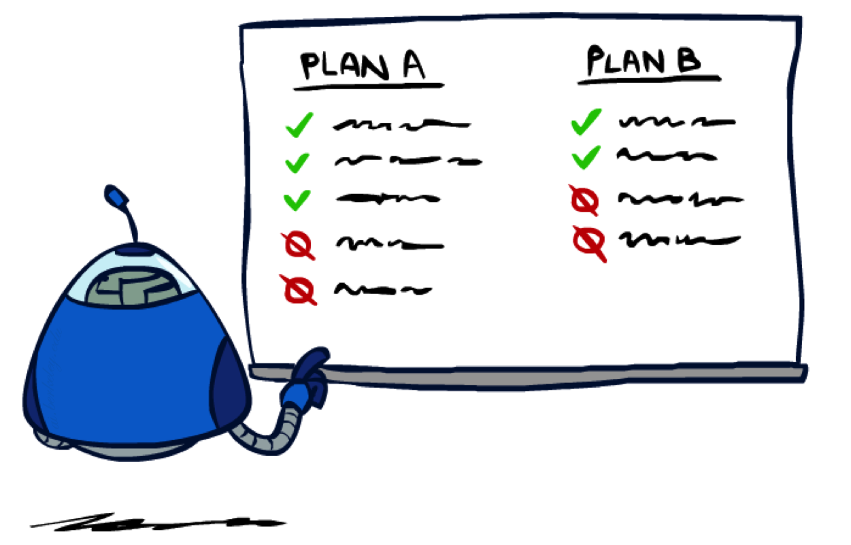
Rationality

Slide 38
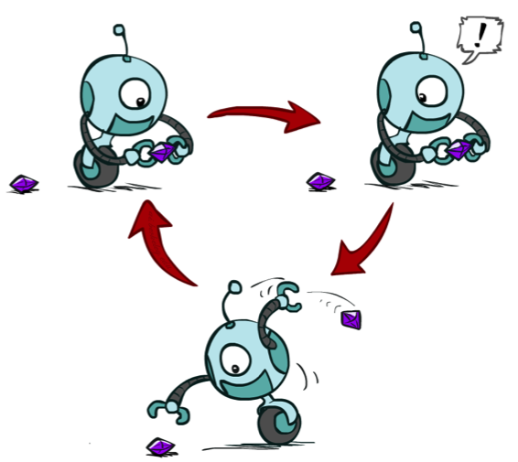
Rational Preferences
We want some constraints on preferences before we call them rational, such as:
For example: an agent with intransitive preferences can
be induced to give away all of its money
If B > C, then an agent with C would pay (say) 1 cent to get B
If A > B, then an agent with B would pay (say) 1 cent to get A
If C > A, then an agent with A would pay (say) 1 cent to get C
Axiom of Transitivity:
Notes:
Apple, banana, carrot

Slide 39

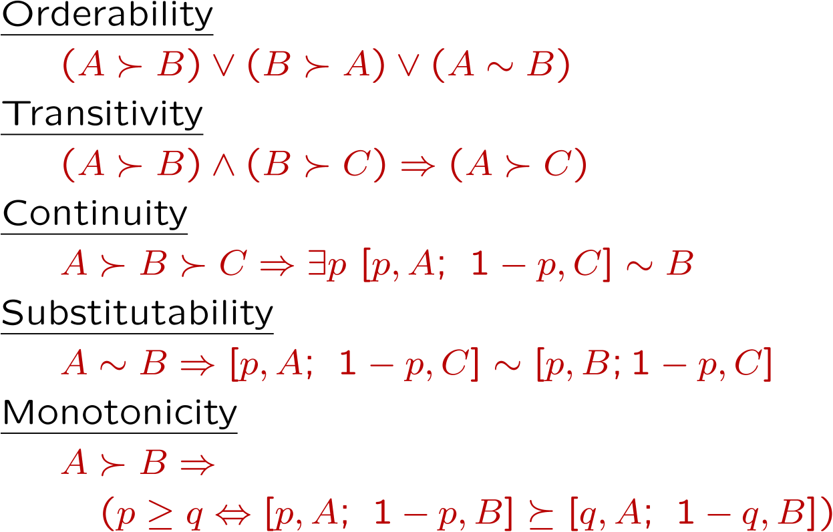
Rational Preferences
The Axioms of Rationality
Theorem: Rational preferences imply behavior describable as maximization of expected utility

Slide 40
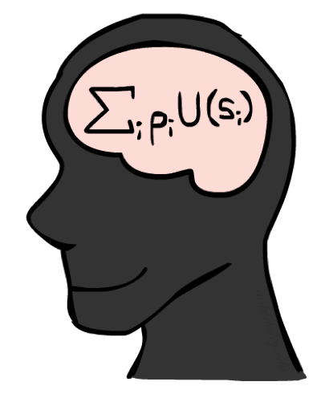
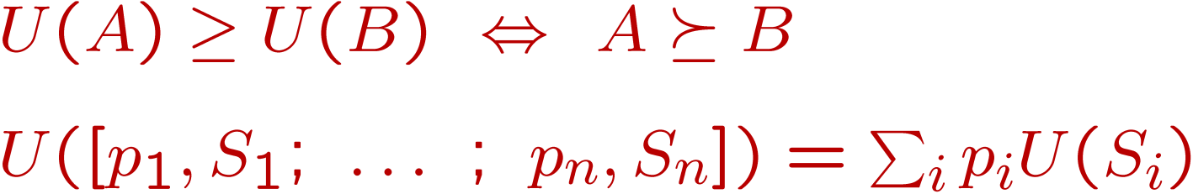
MEU Principle
Theorem [Ramsey, 1931; von Neumann & Morgenstern, 1944]
Given any preferences satisfying these constraints, there exists a real-valued
function U such that:
Chance nodes of Expectimax
i.e. values assigned by U preserve preferences of both prizes and lotteries!
Maximum expected utility (MEU) principle:
Choose the action that maximizes expected utility
Note: an agent can be entirely rational (consistent with MEU) without ever representing or manipulating utilities and probabilities (coincidence, no need to run Expectimax)
E.g., a lookup table for perfect tic-tac-toe, a reflex vacuum cleaner

Slide 41
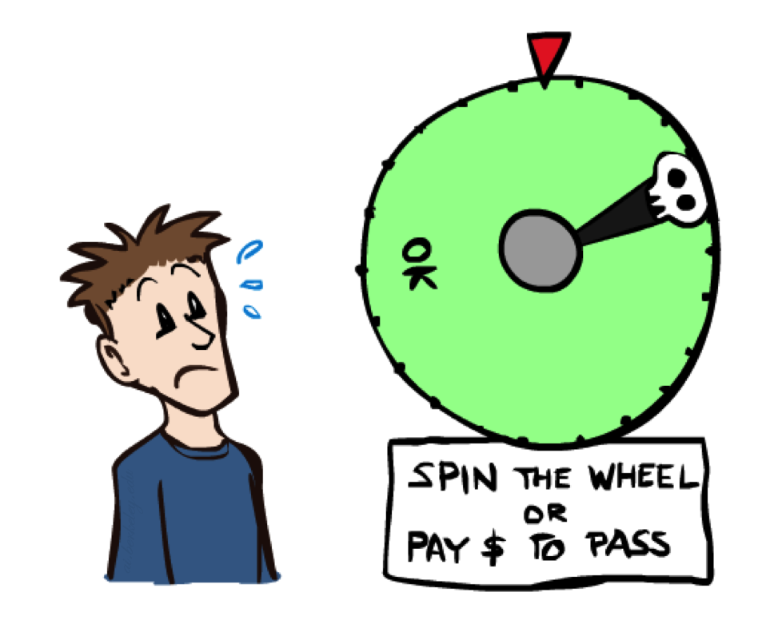
Human Utilities

Slide 42

Utility Scales
Normalized utilities: u₊ = 1.0, u₋ = 0.0
Micromorts: one-millionth chance of death, useful for paying to reduce product risks, etc.
QALYs: quality-adjusted life years, useful for medical decisions involving substantial risk
Note: behavior is invariant under positive linear transformation
With deterministic prizes only (no lottery choices), only ordinal utility can be determined, i.e., total order on prizes

Slide 43


Human Utilities
Utilities map states to real numbers. Which numbers?
Standard approach to assessment (elicitation) of human utilities:
Compare a prize A to a standard lottery L_{p} between
“best possible prize” u₊ with probability p
“worst possible catastrophe” u₋ with probability 1-p
Adjust lottery probability p until indifference: A ~ L_{p}
Resulting p is a utility in [0,1]
Pay $30
0.999999 0.000001
No change
Instant death

Slide 44
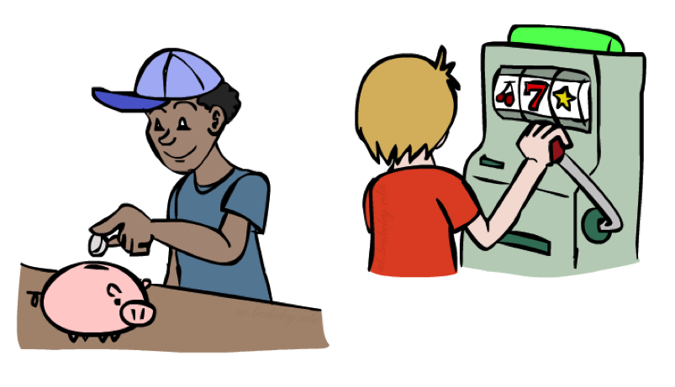
Money
Money does not behave as a utility function, but we can talk about the utility of having money (or being in debt)
Given a lottery L = [p, $X; (1-p), $Y]
The expected monetary value EMV(L) is p*X + (1-p)*Y
U(L) = p*U($X) + (1-p)*U($Y)
Typically, U(L) < U( EMV(L) )
People often prefer to have a guarantee over the EMV in terms of dollars, rather than dealing with a lottery
In this sense, people are risk-averse
When deep in debt, people are risk-prone
Notes:
Draw Jensen’s for utility curve

Slide 45
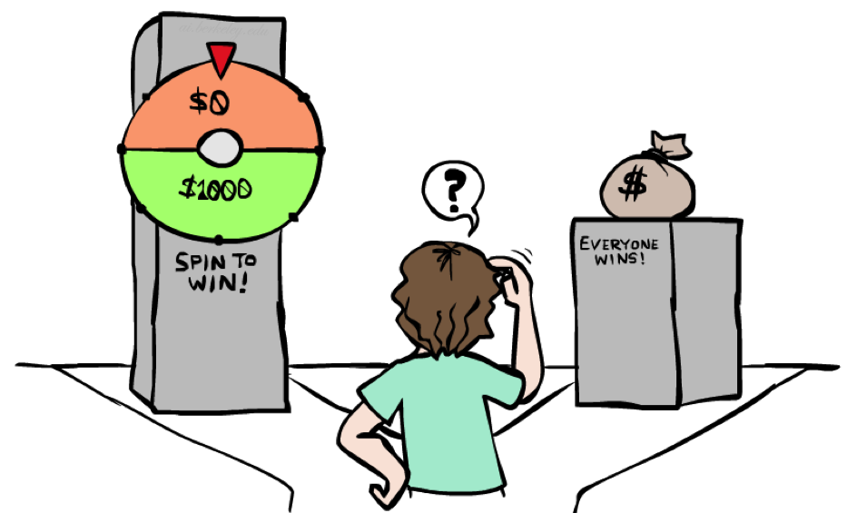
Example: Insurance
Consider the lottery [0.5, $1000; 0.5, $0]
What is its expected monetary value? ($500)
What is its certainty equivalent?
Monetary value acceptable in lieu of lottery
$400 for most people
Difference of $100 is the insurance premium
There’s an insurance industry because people will pay to reduce their risk
If everyone were risk-neutral, no insurance needed!
It’s win-win: you’d rather have the $400 and the insurance company would rather have the lottery (their utility curve is flat and they have many lotteries)

Slide 46

Example: Human Rationality?
Famous example of Allais (1953)
A: [0.8, $4k; 0.2, $0]
B: [1.0, $3k; 0.0, $0]
C: [0.2, $4k; 0.8, $0]
D: [0.25, $3k; 0.75, $0]
Most people prefer B > A, C > D
But if U($0) = 0, then
B > A ⇒ U($3k) > 0.8 U($4k)
C > D ⇒ 0.2 U($4k) > 0.25 U($3k) 0.8 U($4k) > U($3k)

